Slide 1
Battle of Cities
Viswanathan Appakkudal Ramani

Slide 2
Persona
Viswa is a city person, and he want to explore new cities. However, due to work reasons, he is allowed to relocate only among these 4 states (New York, New Jersey, Connecticut, and Pennsylvania). He want to find a city of his choice to relocate. ‘
His expectations about a city are:
Coffee
Convenience stores
Restaurants
Food trucks / Fast food joints
No/Limited Pubs and Bars
What would his next city to reside would be?

Slide 3
Data acquisition and cleaning
Gathering list of cities from
https://en.wikipedia.org/wiki/List_of_United_States_cities_by_population.
Extracting data from wiki page using Beautiful soup.
Discarding unnecessary columns, and keeping only State, City columns
Gathering list of top 100 trending venues using Foursquare API.
Concatenating the venues data frame and cities data frame together

Slide 4
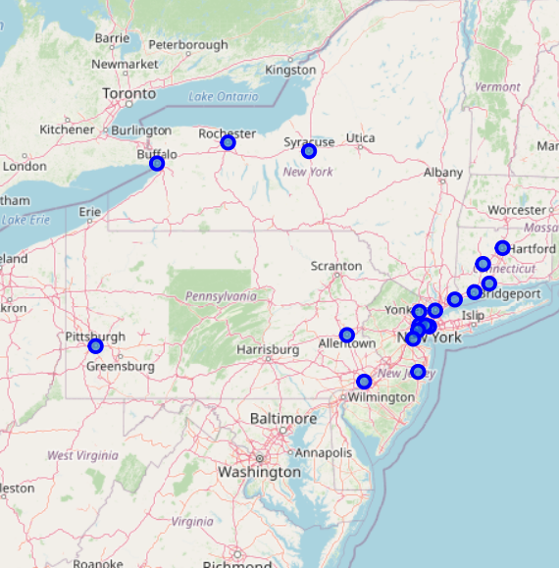
Data Visualization
Visualizing all the cities on a map using Folium.
Circle markers represent the cities on East Coast of United States
Totally 19 cities are strong contenders for the project

Slide 5
Exploratory Data Analysis
One hot encode the venues and find the mean, such that to find the trending venues in every city
Get the top 10 venues across every city
Make a new data frame and display all the cities and corresponding top 10 venues

Slide 6
Modeling
Weighted voting
Weighted voting is a mechanism in which each representative has a variable voting power as determined by the number principals who have made that person their proxy, or the population or the electorate they serve.
Based on user’s preferences, higher points are given to venues they like, and less/negative points to the venues they dislike.
For instance: Coffee can earn a maximum of 12 points, whereas Pubs/Bars can earn a maximum -12 points.
And the points are also based on the trending #. If Coffee trends #1, it get maximum points, and the point scale decreases as the trending # decreases, likewise for Pubs/Bars (in a negative scale).
Based on the total points earned, we decide the winner by the city that earns the maximum points.

Slide 7
Results
City | 1th Most Common Venue | 2th Most Common Venue | 3th Most Common Venue | 4th Most Common Venue | 5th Most Common Venue | 6th Most Common Venue | 7th Most Common Venue | 8th Most Common Venue | 9th Most Common Venue | 10th Most Common Venue | Total
Elizabeth | Pizza Place | Discount Store | Coffee Shop | Theater | Burger Joint | South American Restaurant | Peruvian Restaurant | Lounge | Fried Chicken Joint | Latin American Restaurant | 17.5
New York City | Coffee Shop | Sandwich Place | Hotel | Gym | Burger Joint | Cocktail Bar | Italian Restaurant | Plaza | Pizza Place | Park | 17.5

Slide 8
Conclusion
Two cities gain the same points (Elizabeth, NJ, and New York City, NJ)
From the look of the table, we could see that Coffee trends more in New York City than in Elizabeth.
Hence, Viswa’s city to relocate ill be New York City.

Slide 9
Thank You

